Slide 1
Topic or Topics | March xx
Fantastic Beasts and How to Taxonomize Them
(A wizarding guide to the Drupal Taxonomy System)
Presented by: Timothy Yoder, Senior Developer at Atla

Slide 2


Timothy Yoder
Senior Developer
Collectors and Connectors in Religion and Theology
Lead Developer for the internal Drupal system that powers Atla’s library metadata assembly and distribution for the Religion Database product

Slide 3
Why Taxonomies?

Slide 4
*Edit This* Content Slide with Large Text - You can duplicate this slide.
The Department for the Regulation and Control of Magical Creatures advisory website is in awful shape: Everything is a jumbled mess on one page.

Slide 5
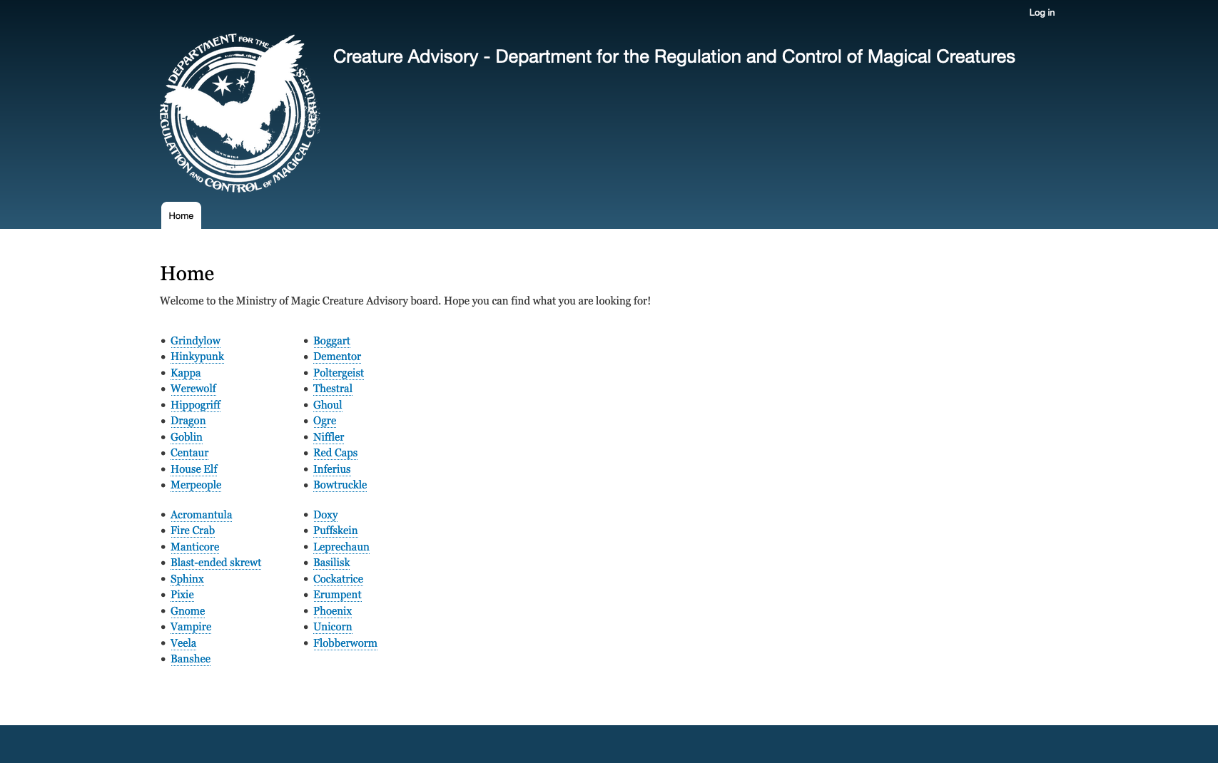
The main landing page is just a bulleted list of creature names
There’s a lot of information available just a link away, but which link is helpful?
The layout itself is information-poor

Slide 6

*Edit This* Content Slide with Large Text - You can duplicate this slide.
This isn’t helpful.

Slide 7
*Edit This* Content Slide with Title and Body Copy - You can duplicate this slide.
Right now, what can’t a user do with this layout?
See a list of all creatures that are dangerous
Find a creature who can be safely domesticated
Narrow down a list of creatures by its habitat

Slide 8
*Edit This* Content Slide with Title and Body Copy - You can duplicate this slide.
What is wrong here?
This does not encourage user interaction and exploration (users might not spend long on the site)
Finding what a user is looking for is burdensome (users might leave and not return)
This is bad for SEO (if the page crawler can’t make connections the site will not rank well)

Slide 9
*Edit This* Content Slide with Large Text - You can duplicate this slide.
Organization is Information

Slide 10
*Edit This* Content Slide with Large Text - You can duplicate this slide.
But first, what are taxonomies?

Slide 11
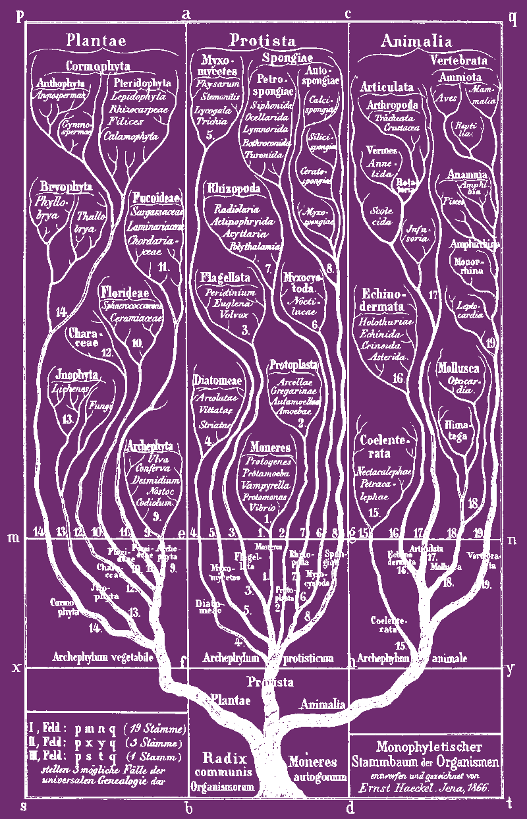
*Edit This* Slide with Photo (1/2 split).
Taxonomy is the practice and science of classifying things. In Drupal, the Taxonomy module allows you to classify your website content, and it can be an important part of your information architecture.
https://www.drupal.org/docs/7/organizing-content-with-taxonomies/about-taxonomies

Slide 12
*Edit This* Slide with Photo (1/2 split).
Taxonomy means assigning categories, tags and other labels to our content in order to create meaningful relationships.

Slide 13
*Edit This* Slide with Photo (1/2 split).
In Drupal your taxonomies are not predefined. You can make them what you want them to be.
They are made up of:
Vocabularies
Terms
Relationships between content and terms

Slide 14
*Edit This* Slide with Photo (1/2 split).
Vocabularies:
These are the collections we are going to make
They can be flat or hierarchical
Terms:
Individual segments belonging to a vocabulary
Can be related to one another with parent/child relationships if the vocabulary is hierarchical
Relationships with content:
Says that the content is an instance of a term
May be limited to one term per content item or not as makes sense for the vocabulary

Slide 15
*Edit This* Slide with Photo (1/2 split).
Example: A flat vocabulary with only one relationship
Ministry of Magic Classification
X (Boring)
XX (Harmless / may be domesticated)
XXX (Competent wizards should cope)
XXXX (Dangerous / requires specialist knowledge / skilled wizard may handle)
XXXXX (Known wizard killer / impossible to train or domesticate)
Features
These categories are independent from one another, meaning that one is not nested below another.
In this case it does not make sense for a content item to have more than one classification

Slide 16
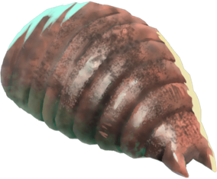
*Edit This* Slide with Photo (1/2 split).
The Flobberworm
Vocabulary: Ministry of Magic Classification
Term: X (Boring)
Relationship with content: The Flobberworm is rated as X (Boring)

Slide 17
*Edit This* Slide with Photo (1/2 split).
Example: A flat vocabulary with more than one relationship possible
Department for the Regulation and Control of Magical Creatures Type
Beast
Being
Spirit
Non-being
Features
These categories are independent from one another, meaning that one is not nested below another.
There are some circumstances where the classification is genuinely ambiguous

Slide 18
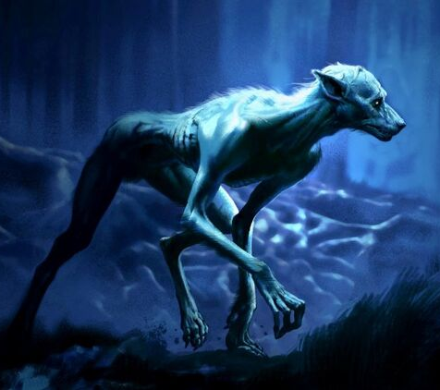
*Edit This* Slide with Photo (1/2 split).
The Werewolf
Vocabulary: Department for the Regulation and Control of Magical Creatures Type
Term: Beast, Being
Relationship with content: The Werewolf is classified as both a beast and a being, depending on state of transformation

Slide 19
*Edit This* Slide with Photo (1/2 split).
Example: A hierarchical taxonomy
Habitat
Forest
Temperate
Rainforest
Aquatic
Freshwater
Ocean
Features
These categories are related hierarchically to each other. Forest is the parent of Rainforest, and Rainforest is the child of Forest
You could keep going with that (breaking Freshwater out into Lakes and Rivers, for example) but you should be careful not to overcomplicate things

Slide 20
*Edit This* Slide with Photo (1/2 split).
Some cautions for using a hierarchical taxonomy
Nesting things too deep adds unnecessary complexity
For your own future sanity, you should try to select parent categories as well as the child categories when creating the relationships
Sure, you could infer the relationship using other means, but keeping your data groomed is often easier

Slide 21
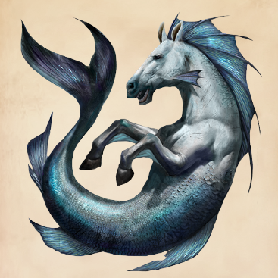
*Edit This* Slide with Photo (1/2 split).
Hippocampus
Vocabulary: Habitat
Term: Aquatic, Ocean
Relationship with content: The Hippocampus is aquatic and lives in the ocean

Slide 22
How to set up our taxonomies

Slide 23
*Edit This* Content Slide with Large Text - You can duplicate this slide.
Let’s go back to the Department for the Regulation and Control of Magical Creatures advisory website

Slide 24
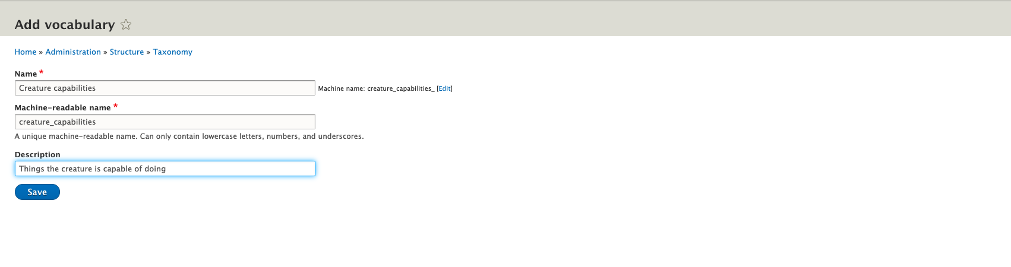
*Edit This* Content Slide with Title and Body Copy - You can duplicate this slide.
Let’s add a vocabulary: Creature Capabilities

Slide 25
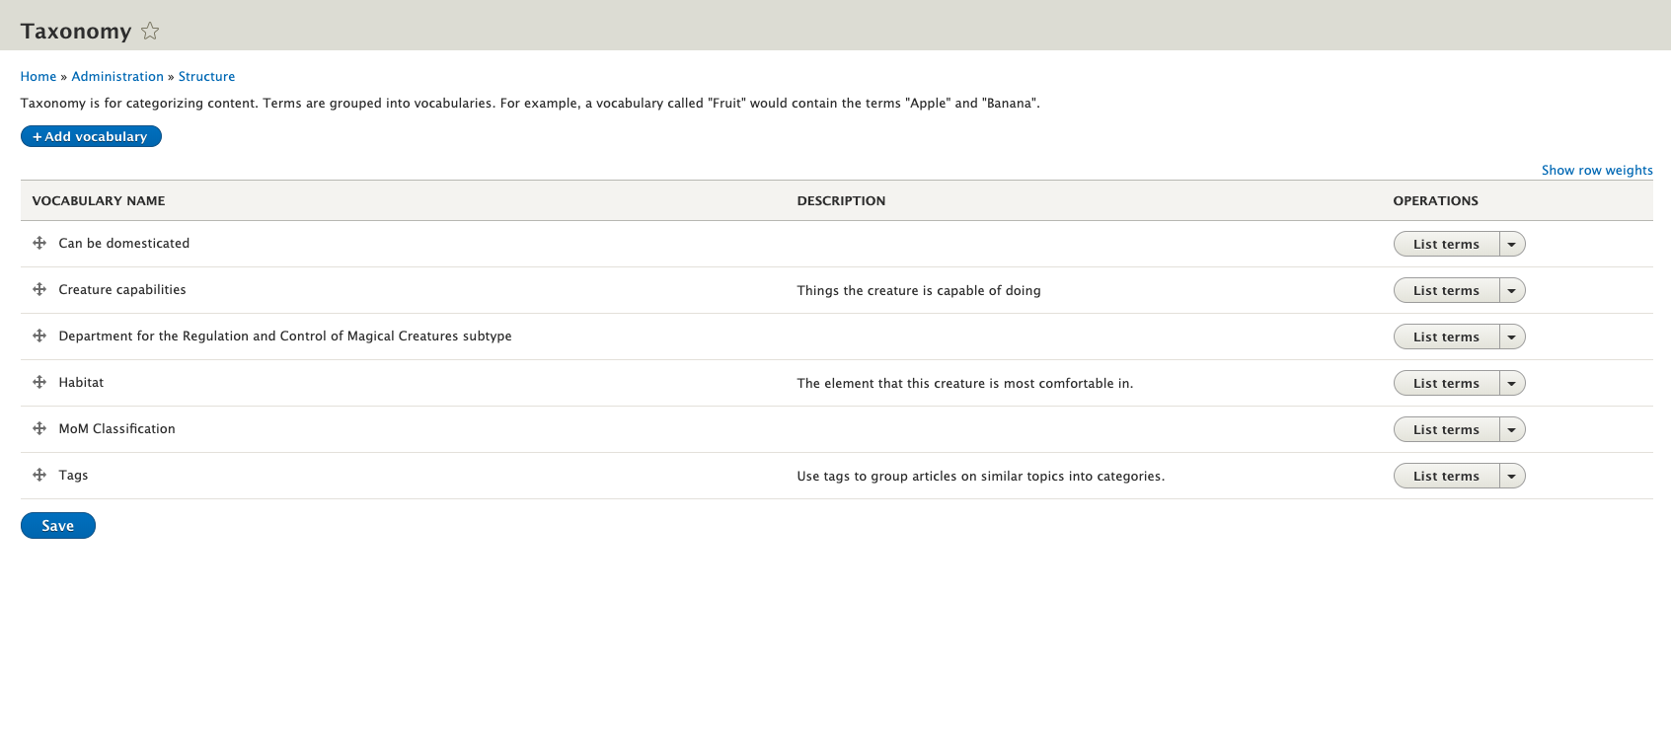
Here it is!
Now let’s go to List Terms

Slide 26
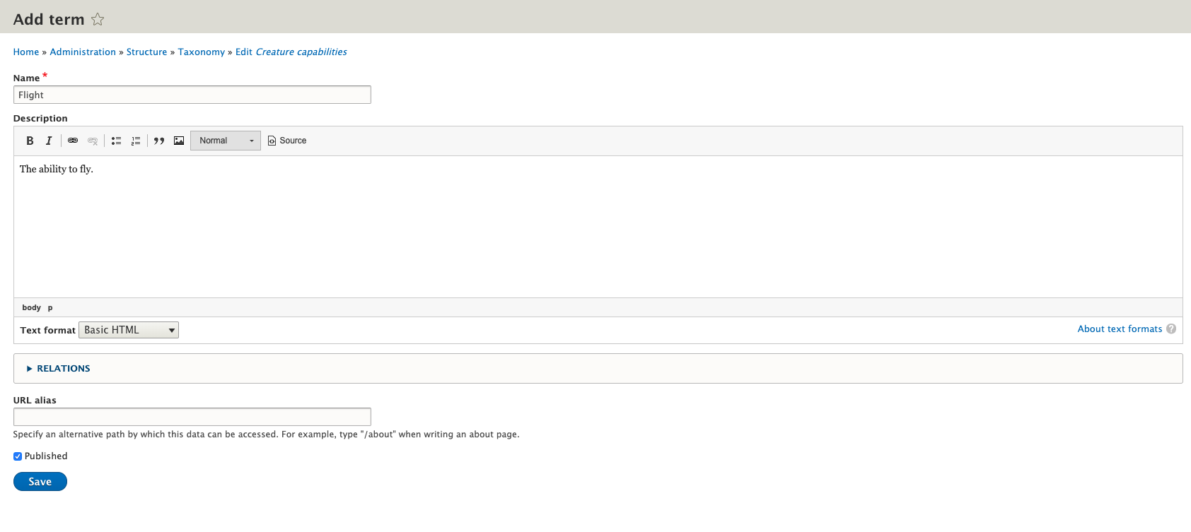
Nothing here, Let’s add a term: Flight

Slide 27
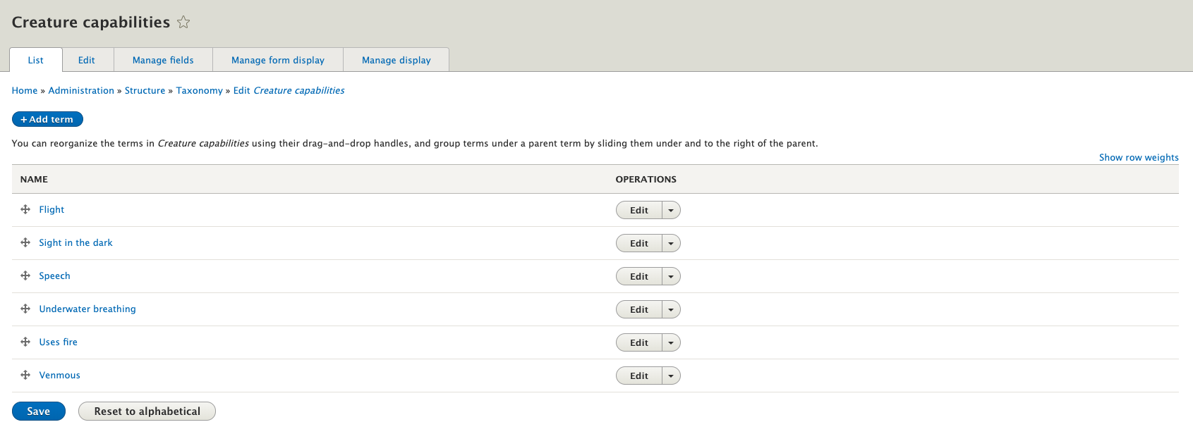
After a few more…

Slide 28
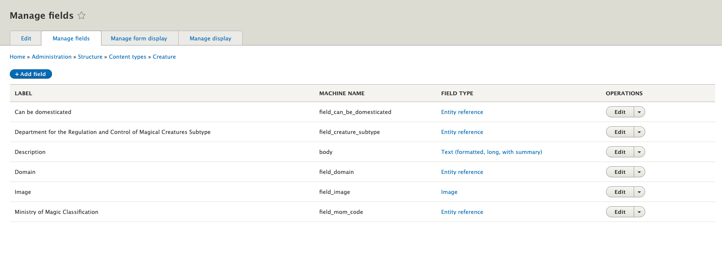
Now let’s add this to our Creature content type
Add a field…

Slide 29
Now let’s add this to our Creature content type
Add a field…

Slide 30
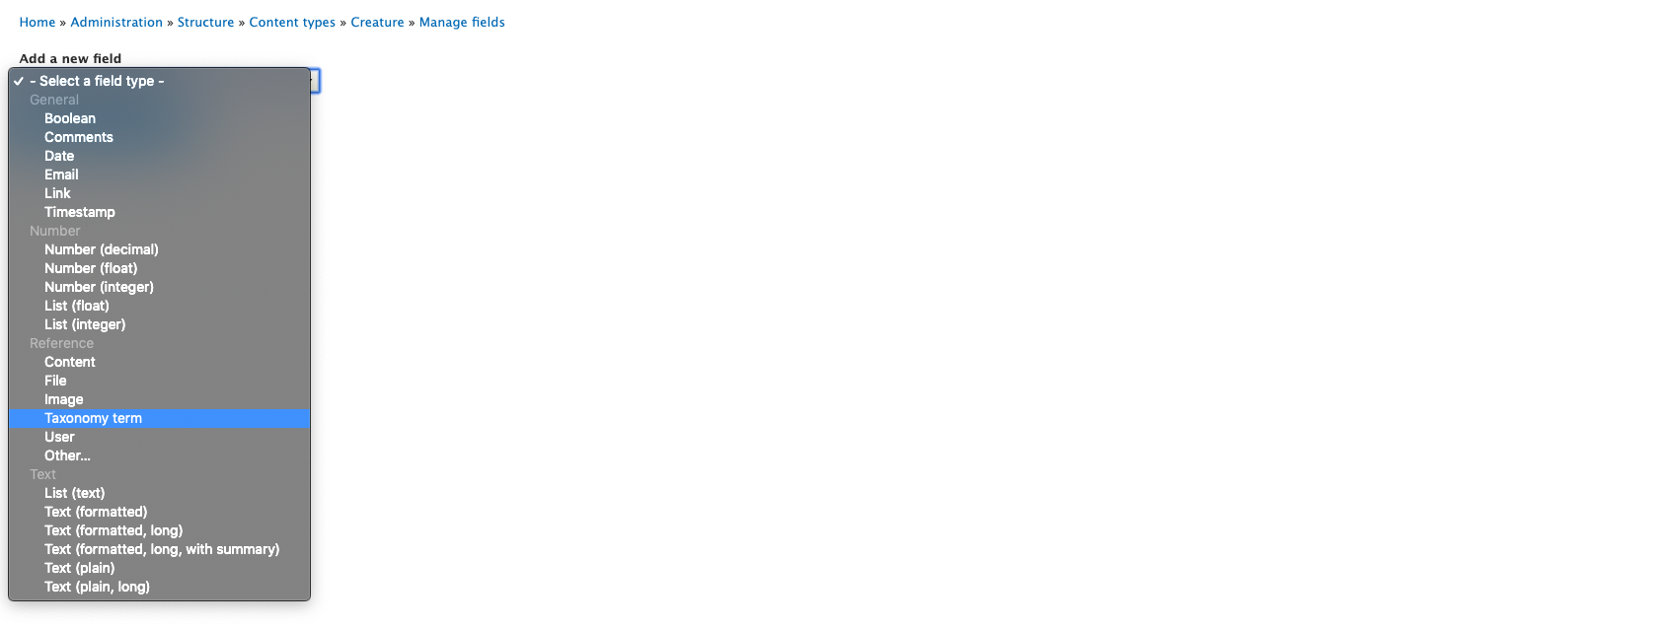
The type we want is Reference->Taxonomy Term

Slide 31
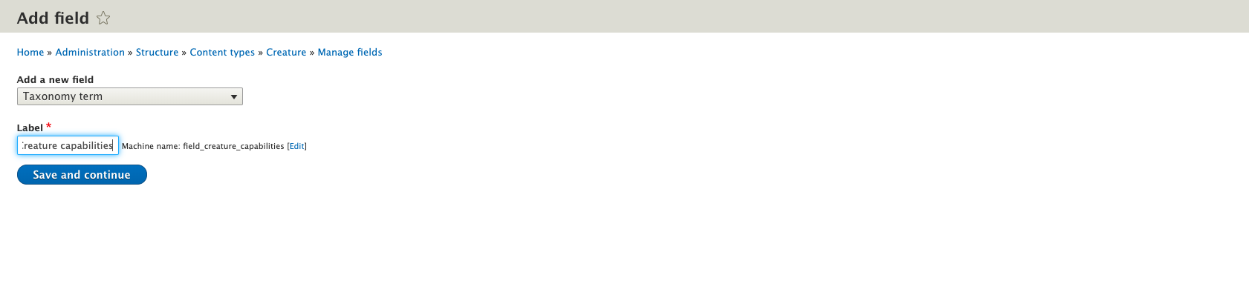
We label it “Creature capabilities”
Then save and continue

Slide 32
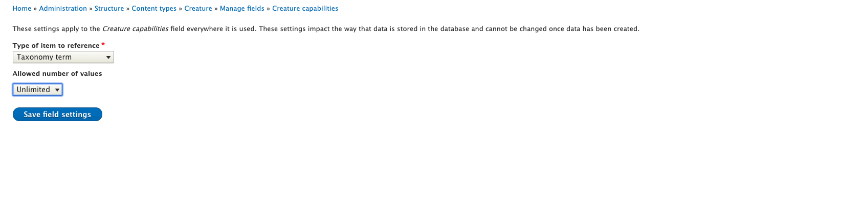
In this case we allow unlimited values because a creature can have many abilities
We save the field settings

Slide 33
In this case we allow unlimited values because a creature can have many abilities
We save the field settings

Slide 34
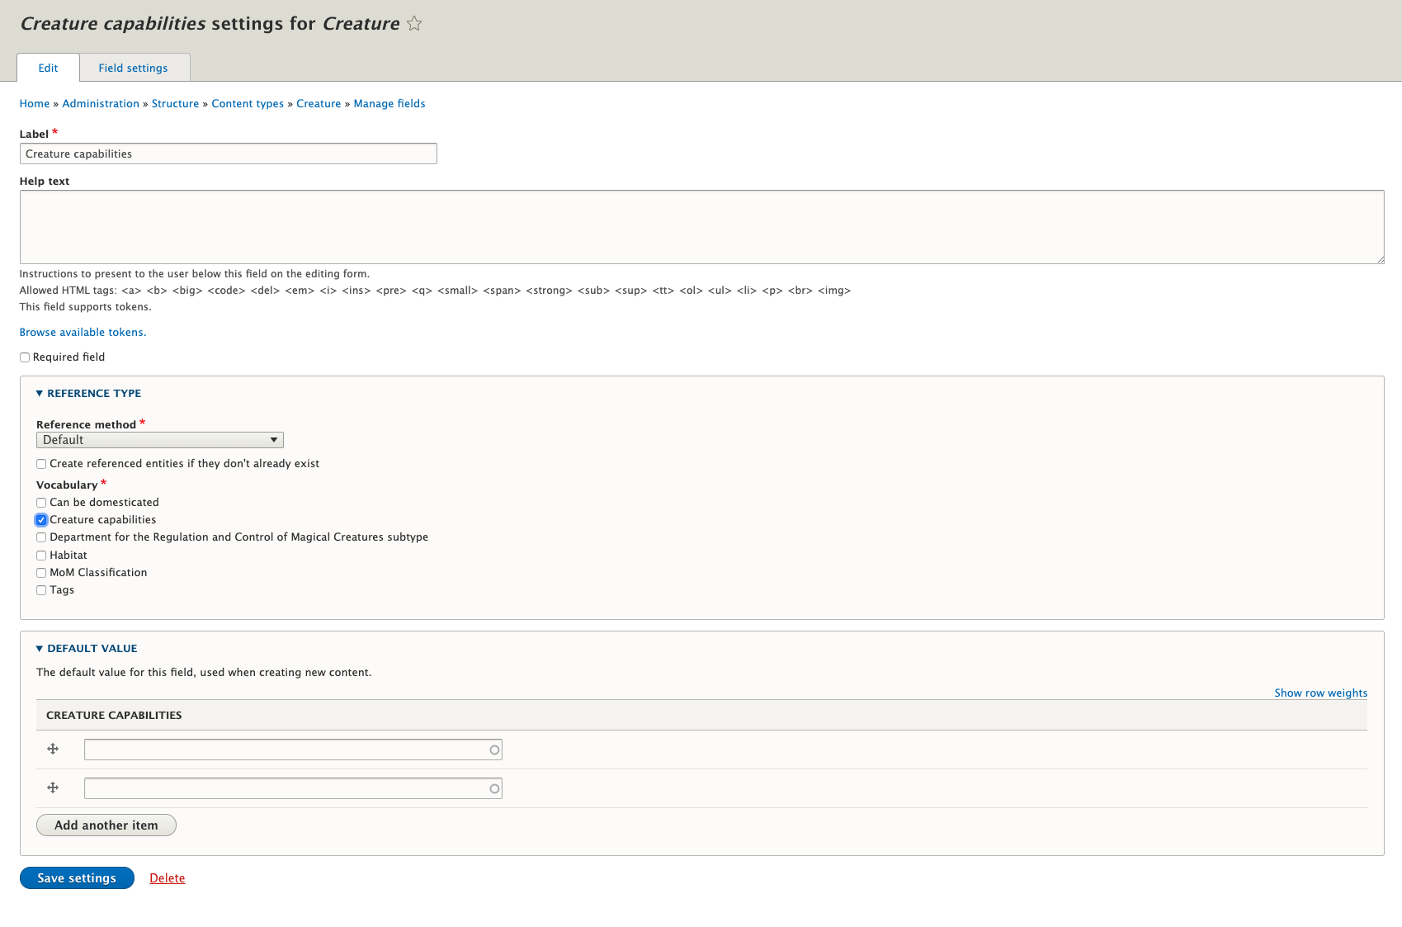
Now we have one more screen
Here we need to tell it which vocabulary to link to
And we save these settings

Slide 35
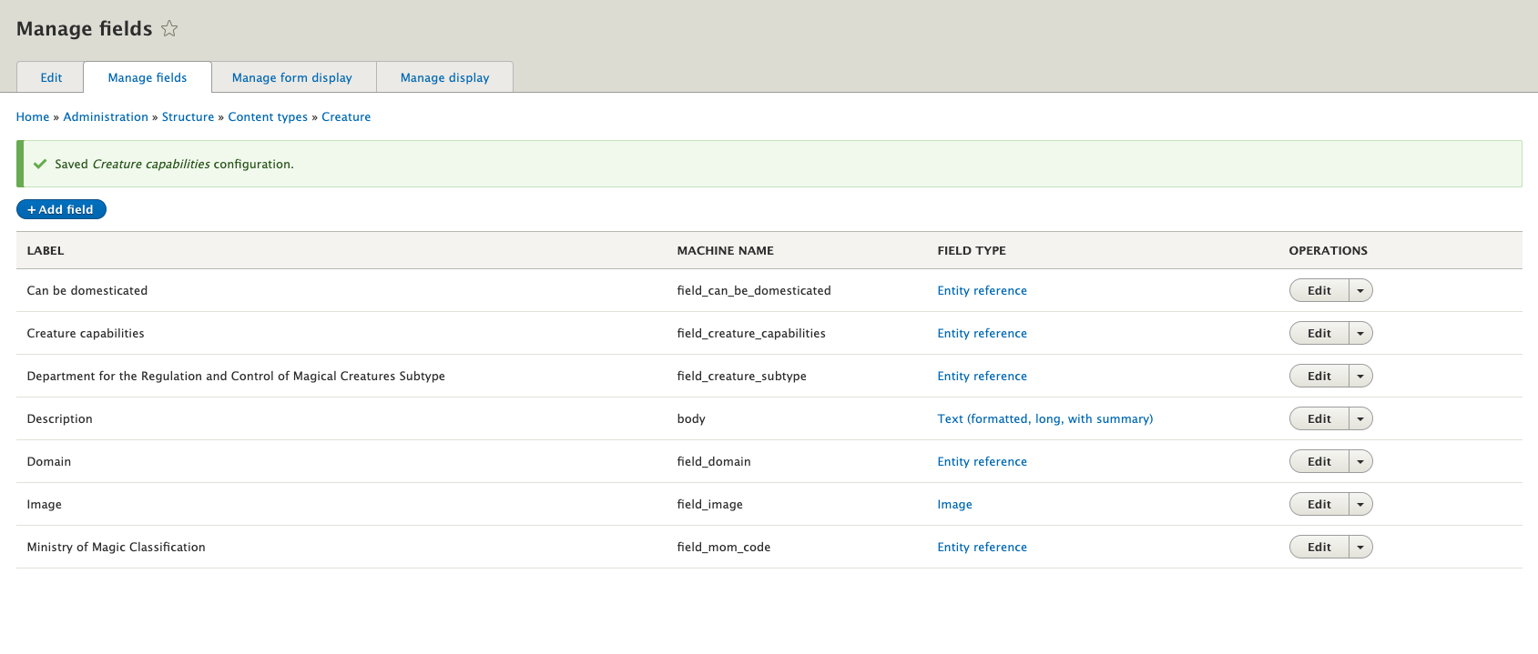
We have one last task now…
We need to click on the manage form display tab

Slide 36
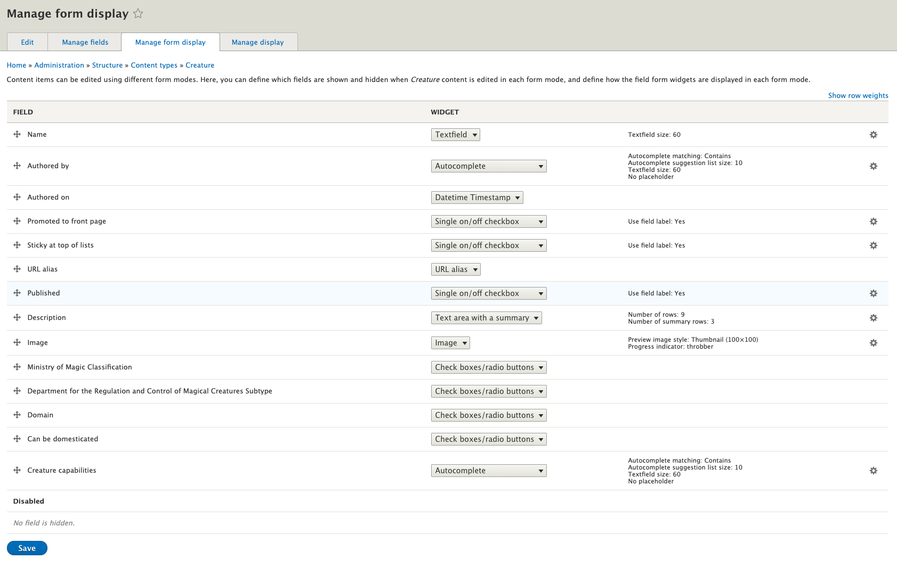
Let’s change the edit widget for Creature Capabilities

Slide 37
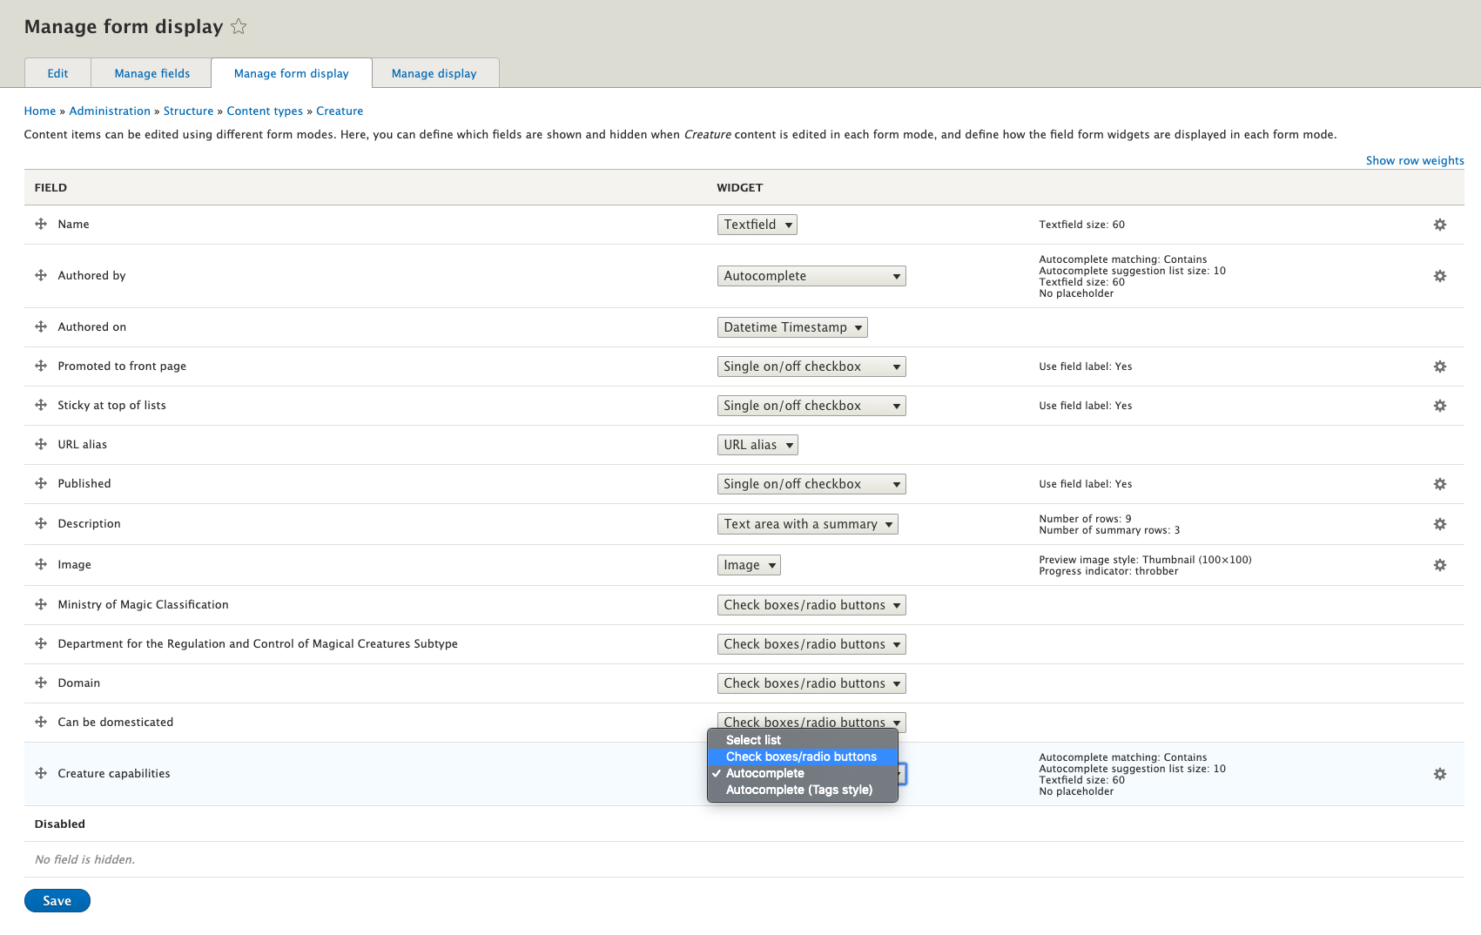
And change it to checkboxes/radio buttons
Pro tip:
Because we allowed this to have unlimited values, we will have checkboxes. Had we only allowed one value the widget would present radio buttons.

Slide 38
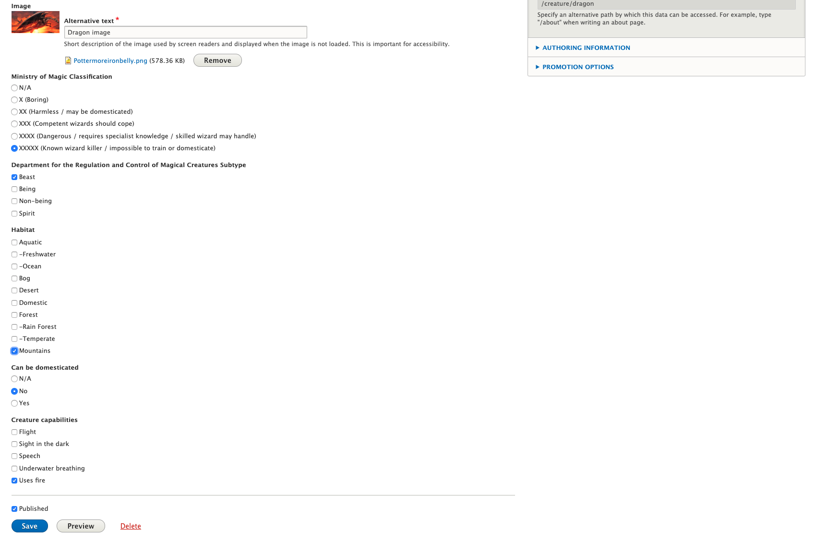
Now we’re ready to add capabilities to our creatures!
Editing the Dragon, let’s add Flight and Uses Fire

Slide 39

We’ve still got a lot more creatures to sort.
“When I call your name, you will put on the hat and sit on the stool to be sorted”

Slide 40
*Edit This* Content Slide with Large Text - You can duplicate this slide.
Now that the taxonomies are in place, what can we do with them?

Slide 41
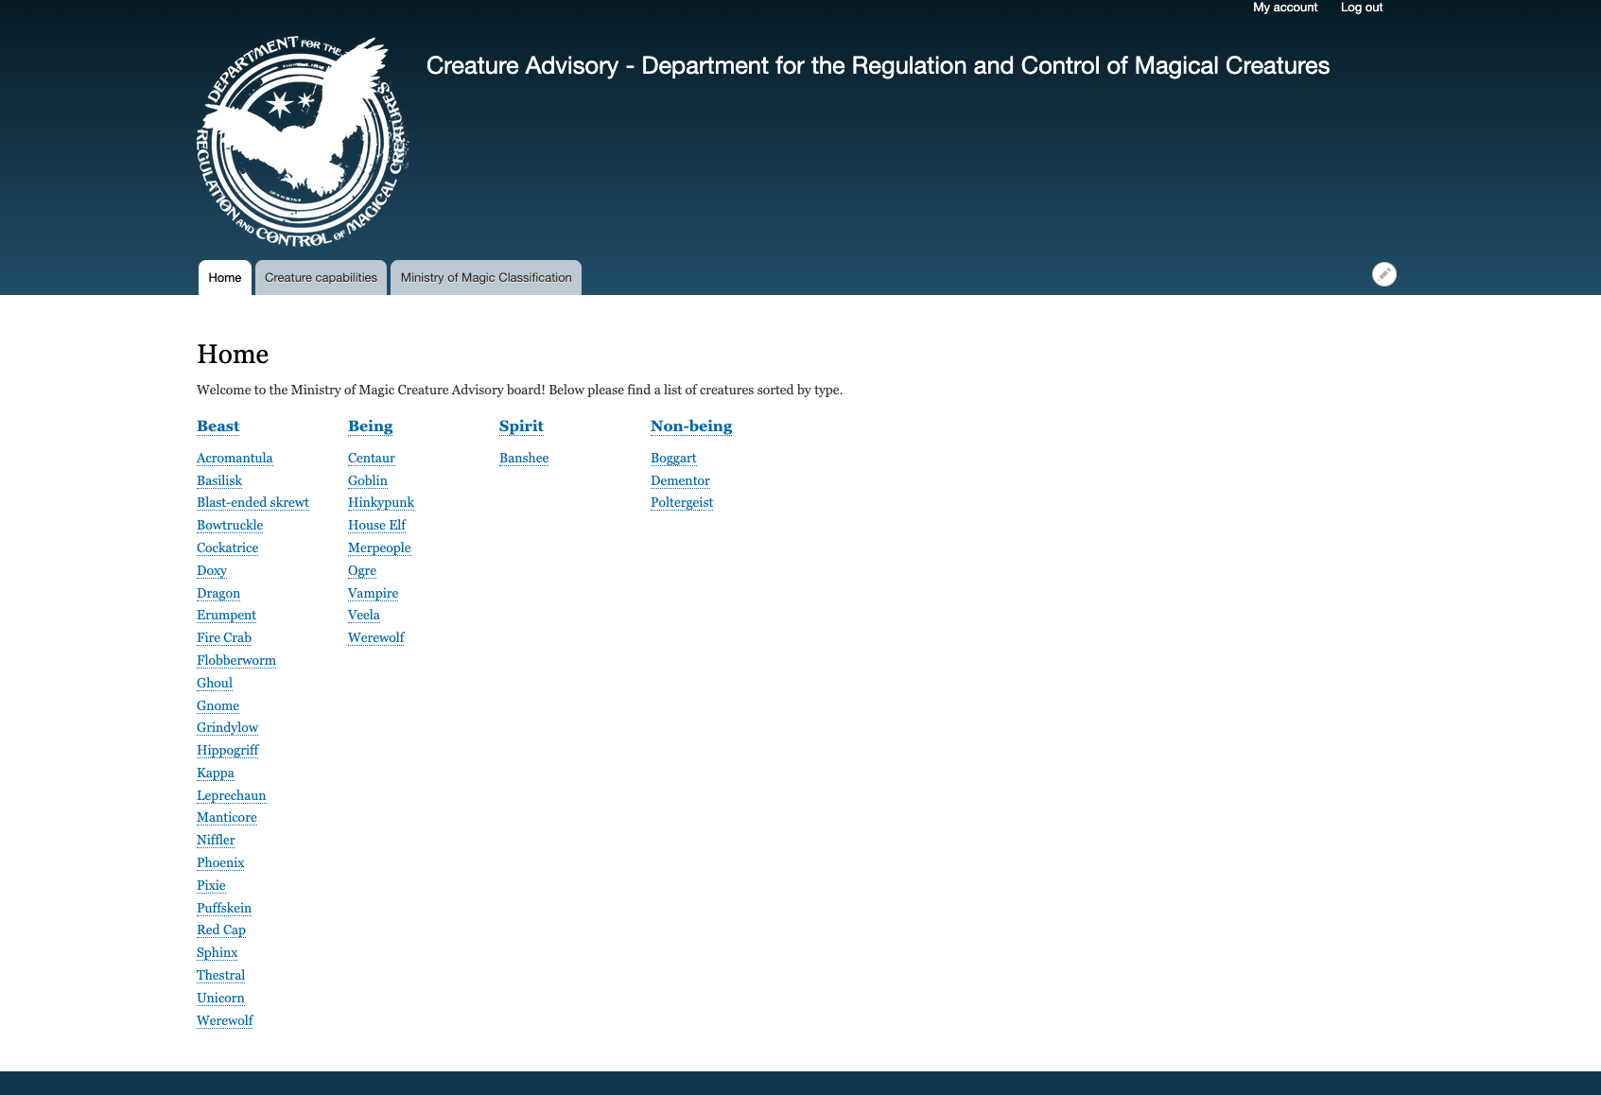
Let’s redo the home page to group creatures by type

Slide 42
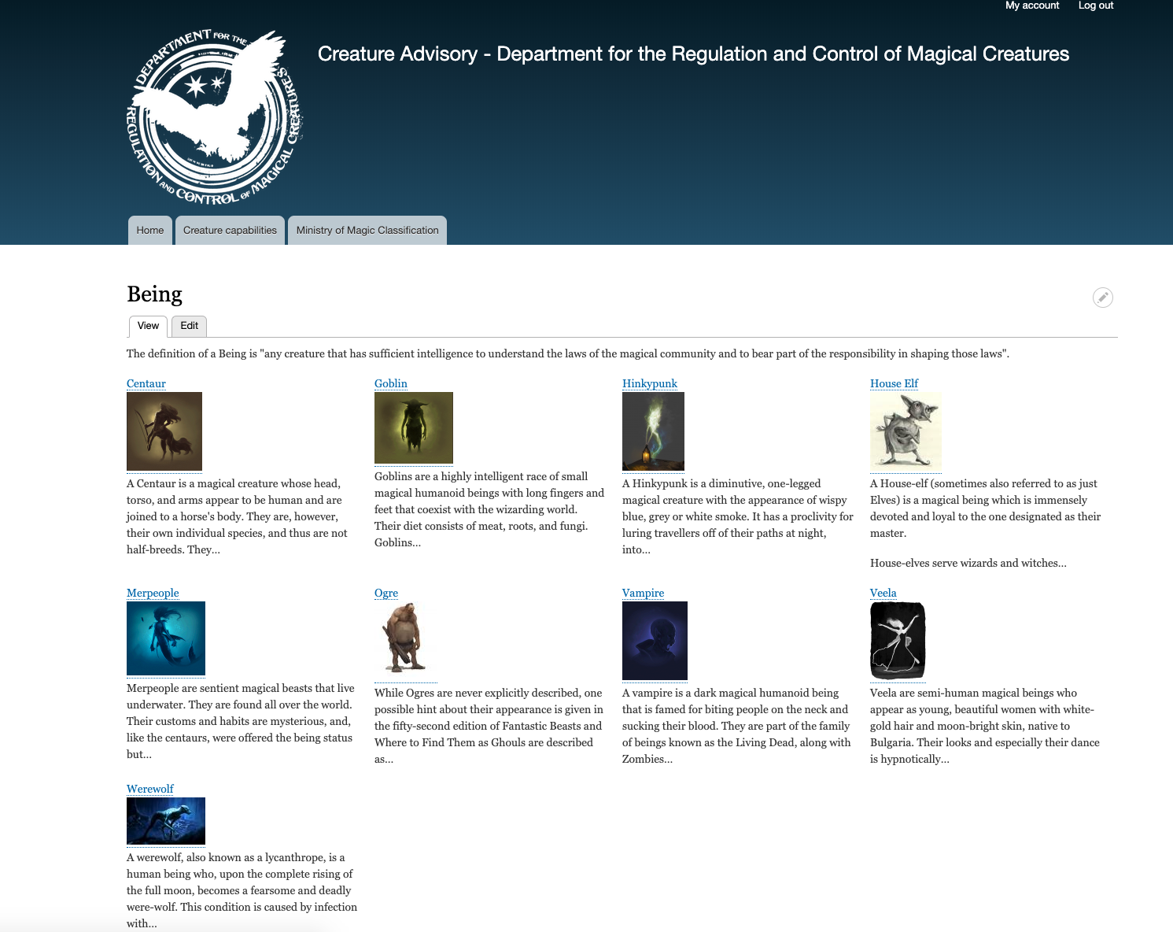
And when you click a subtype heading…

Slide 43
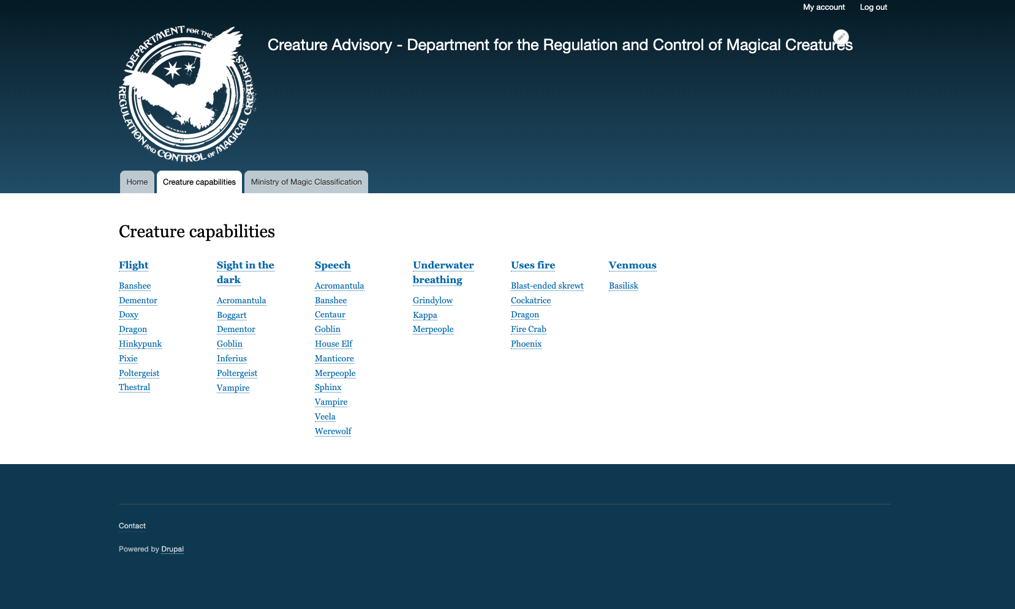
Creature capabilities can have a page too…

Slide 44
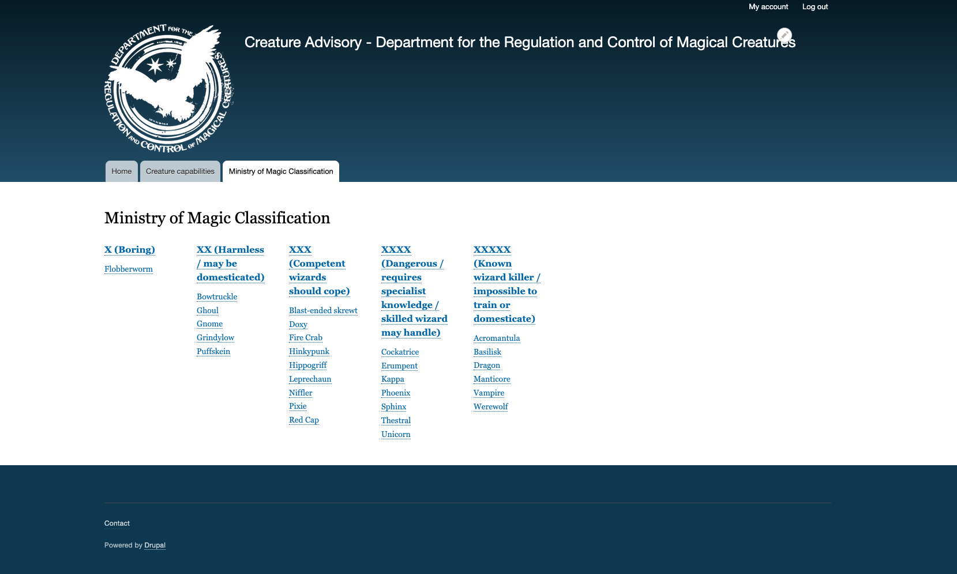
And so can the Ministry of Magic Classification!

Slide 45
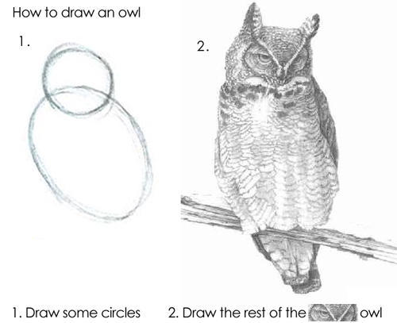
But slow down… How did we get here?

Slide 46
The secret second part: Views integration

Slide 47
To make the most of our new taxonomies we need to use views
Let’s go over how to create the creature type view

Slide 48
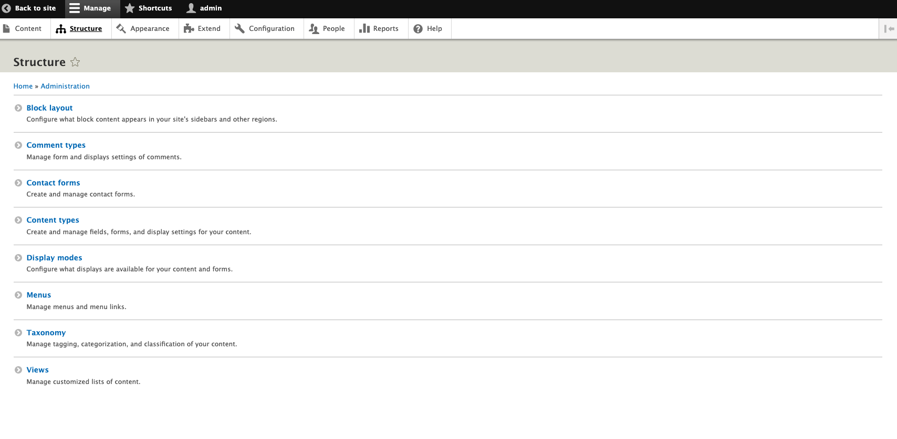
Under structure go to Views

Slide 49
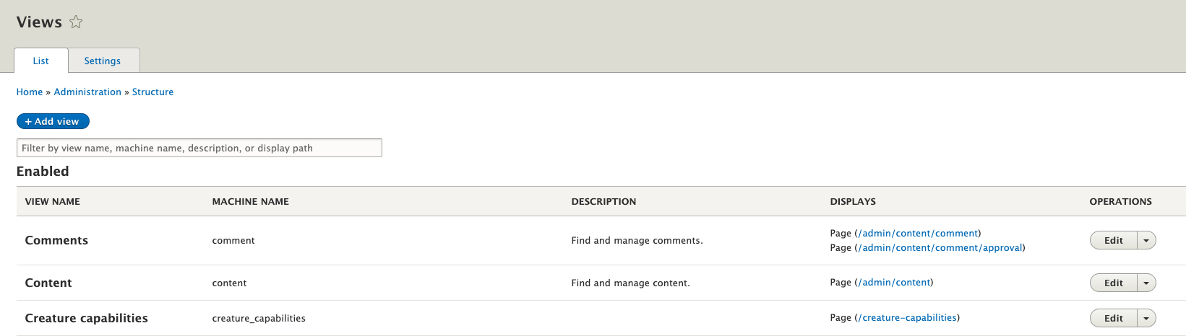
Then add a new View

Slide 50
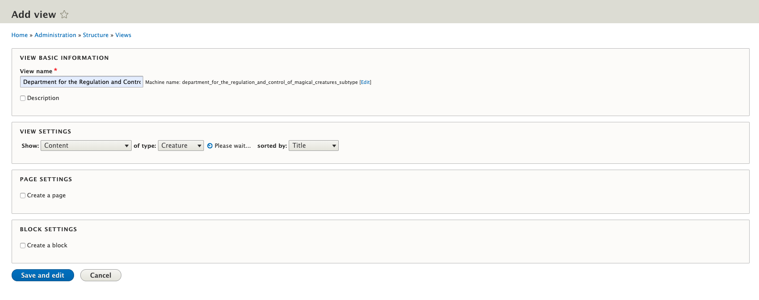
Give the View a Name and choose to show content of Type Creature
Then check the box to create a page

Slide 51
Give the View a Name and choose to show content of Type Creature
Then check the box to create a page

Slide 52
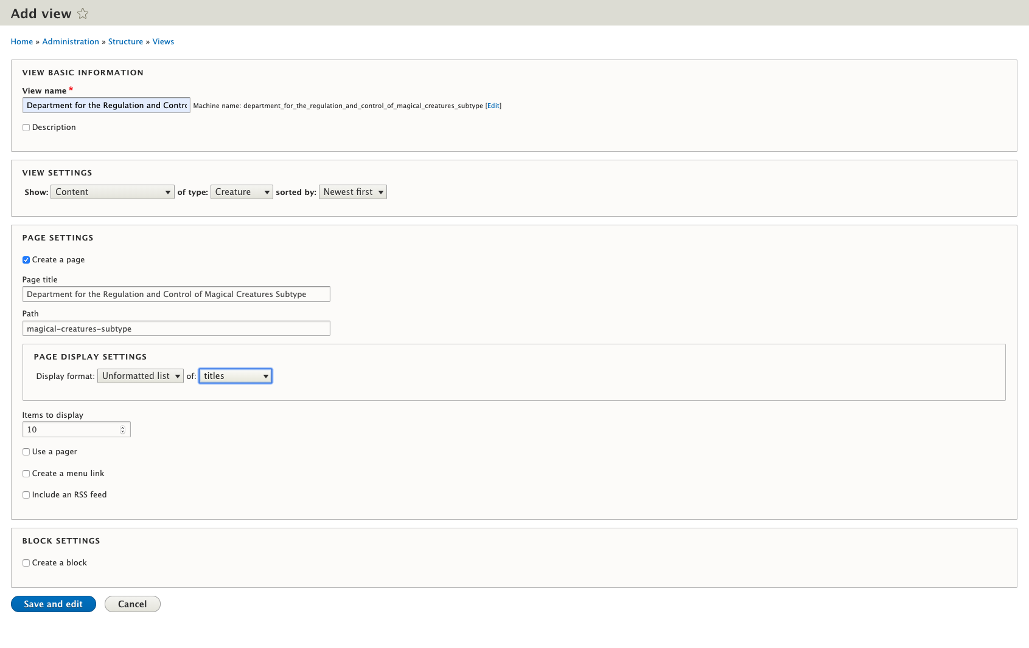
Title the page, give it a path
Then change the display format to an HTML list of titles (also, either set the number of items high or remove the limit later)

Slide 53
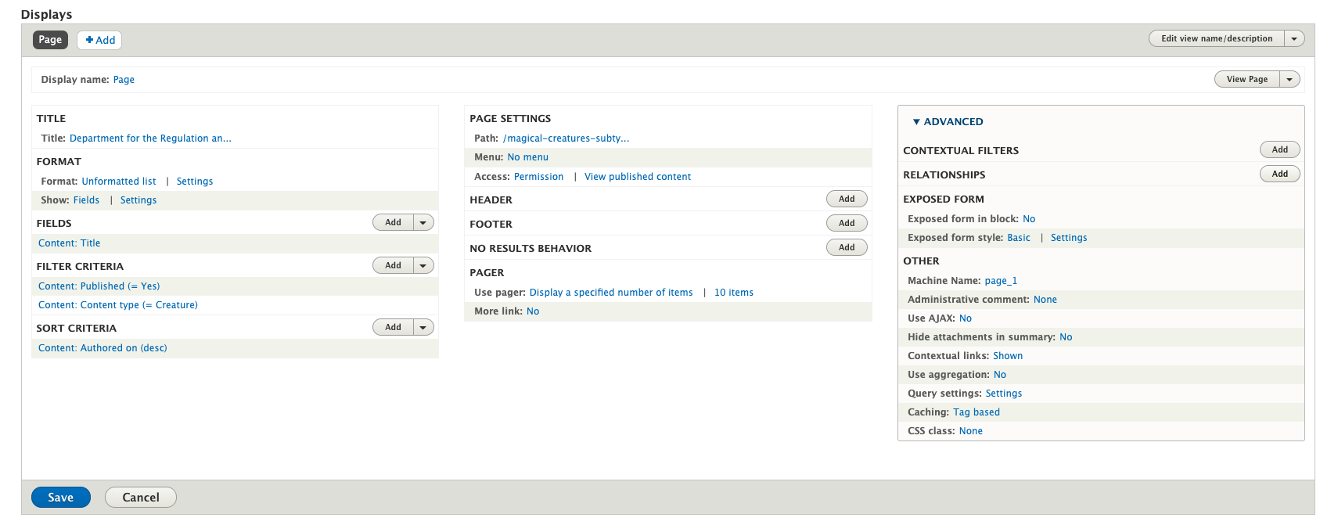
Expand the advanced settings and add a relationship

Slide 54
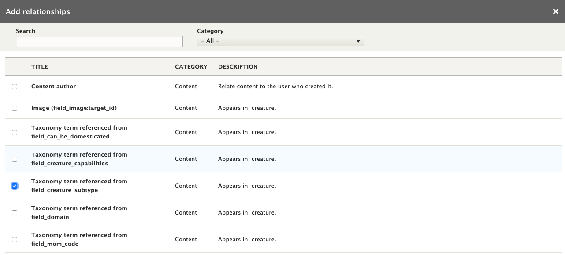
Select the Taxonomy term referenced from the creature subtype field.

Slide 55
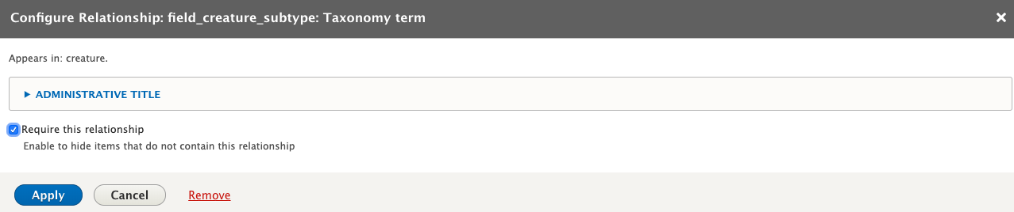
Check the box requiring this relationship (in other words if this creature doesn’t have a subtype, don’t show it.)
Pro tip:
For those familiar with SQL this is the equivalent of using an inner join rather than a left join.

Slide 56
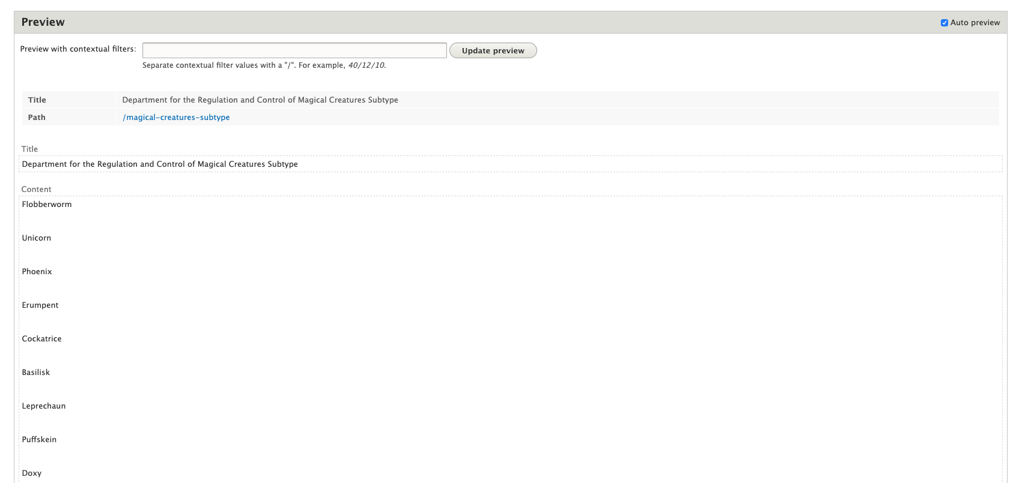
Under Preview we don’t have much to look at yet, just a list of content. The term names don’t even link yet.

Slide 57
Click on Content: Title to edit it

Slide 58
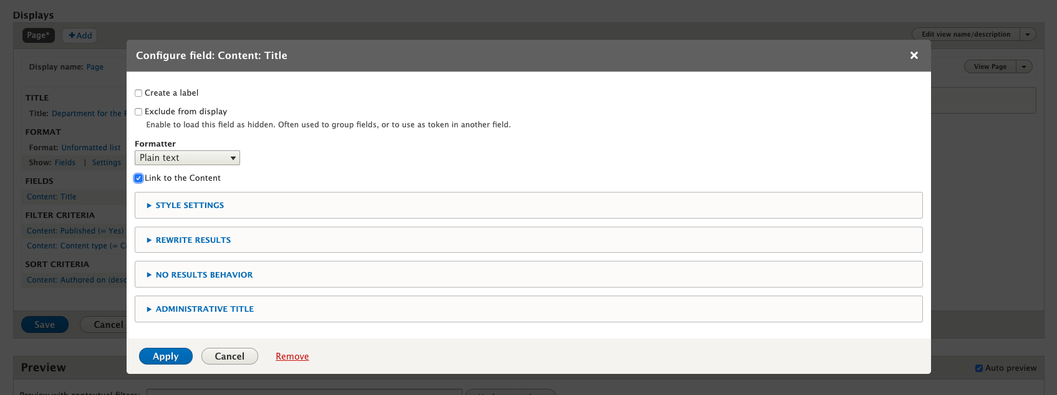
Check the box to link the title to the content

Slide 59
Now click to add a field

Slide 60
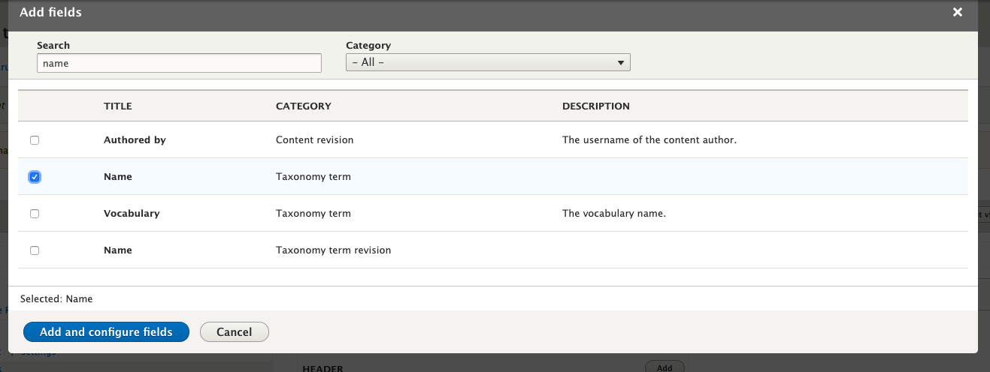
We are looking for the taxonomy term name. Type name in the search box.
Check the checkbox for Name and click Add and configure fields

Slide 61
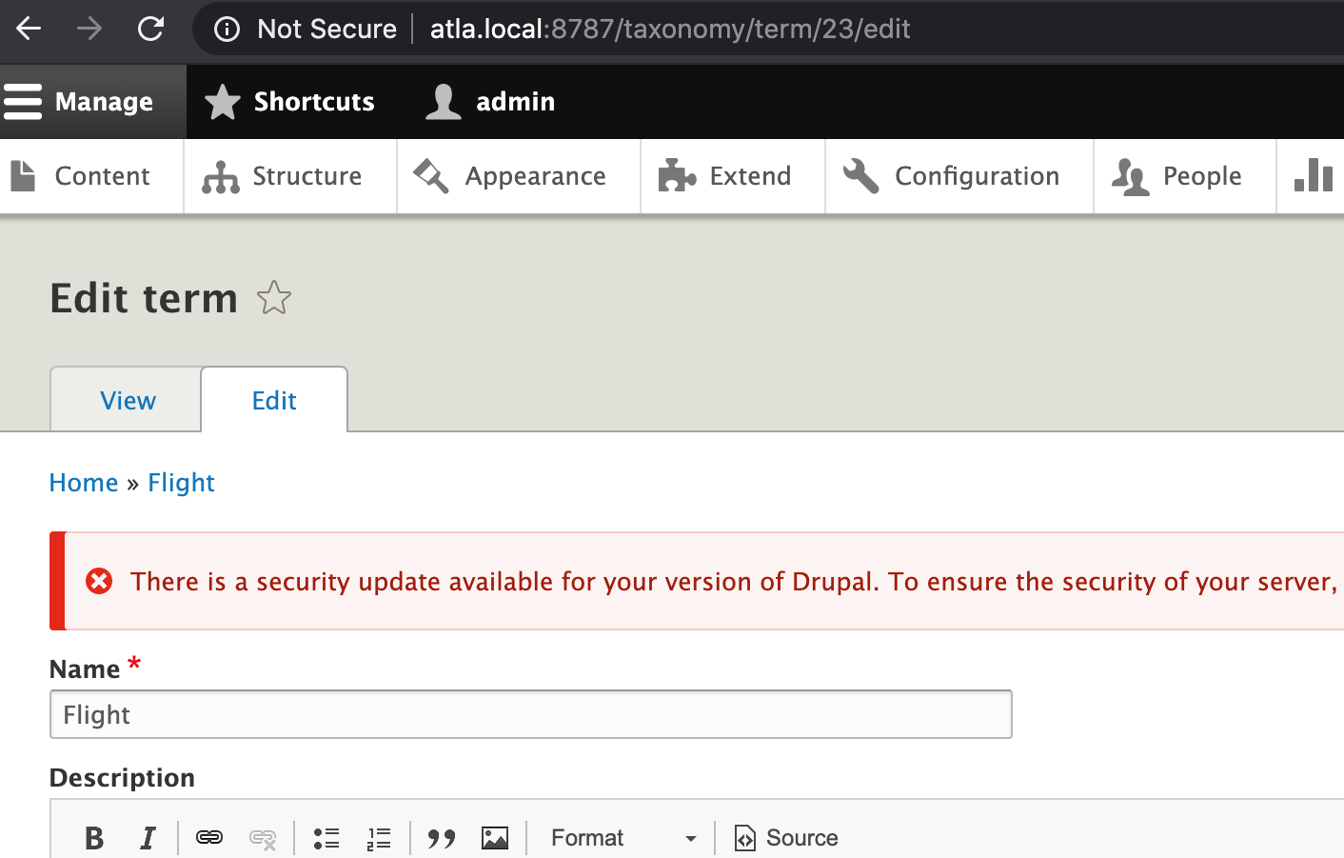
A closer look at the anatomy of a taxonomy term:
There is a taxonomy term id (or tid) and a name. These are equivalent to the node id and title on content.

Slide 62
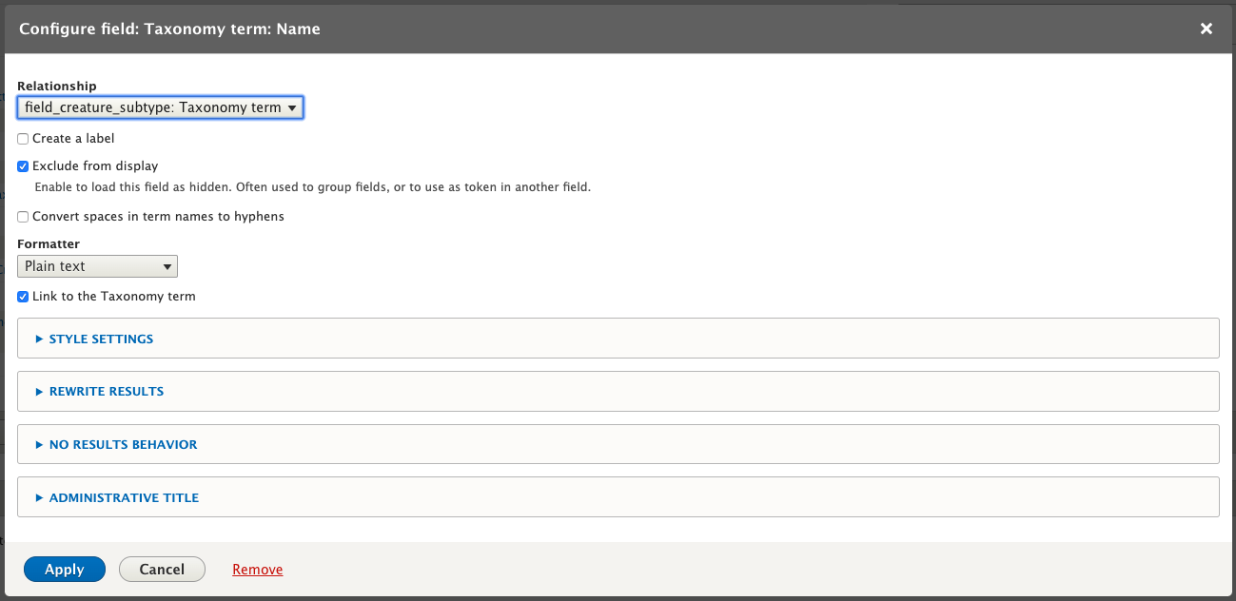
Ensure that the relationship is selected, and check the box to exclude this from display
Also, check the box to link this to a taxonomy term.

Slide 63
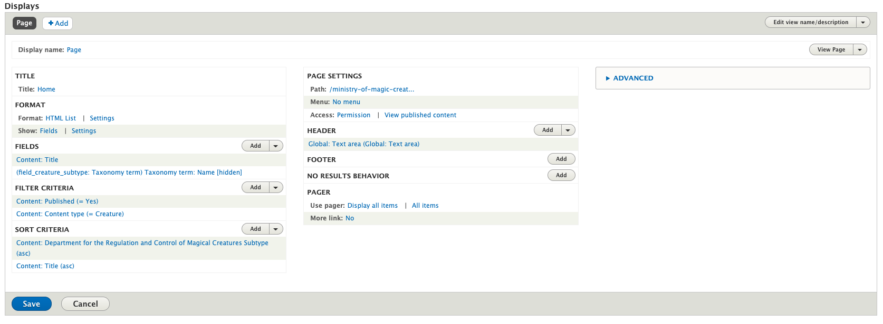
Back under format, click settings

Slide 64
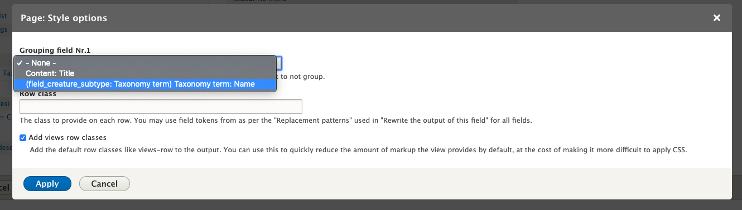
Choose our Taxonomy Term name under Grouping field Nr. 1
We may have hidden this field, but it will now show up as a grouping heading

Slide 65
Now click on the existing sort criteria

Slide 66
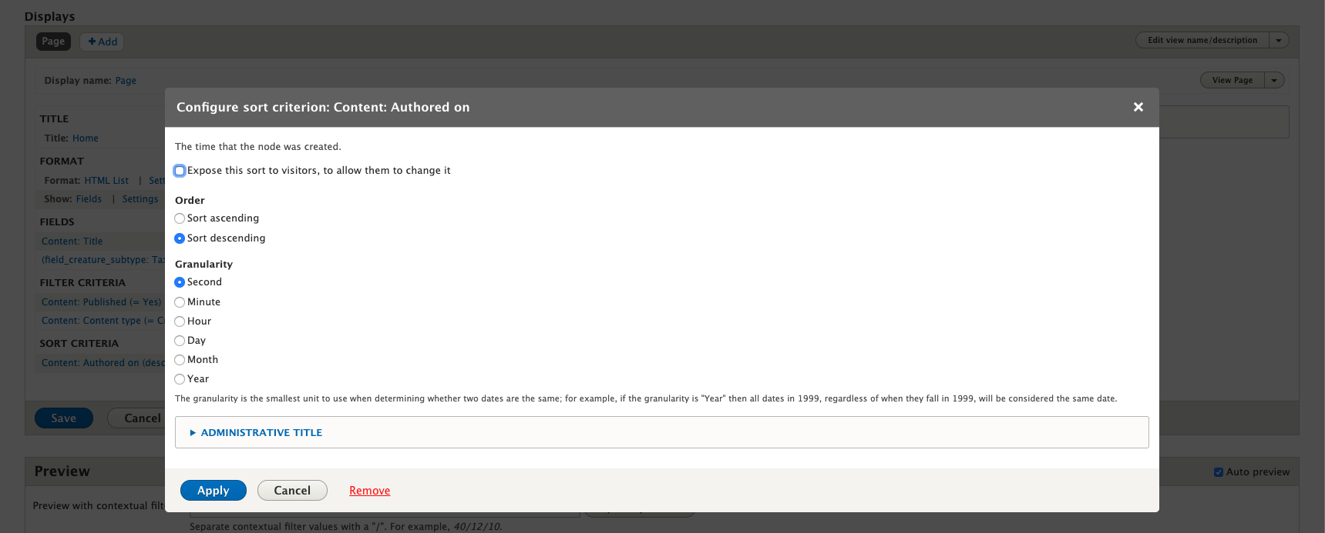
Remove it-we’re going to use something different

Slide 67
Now let’s add our own

Slide 68
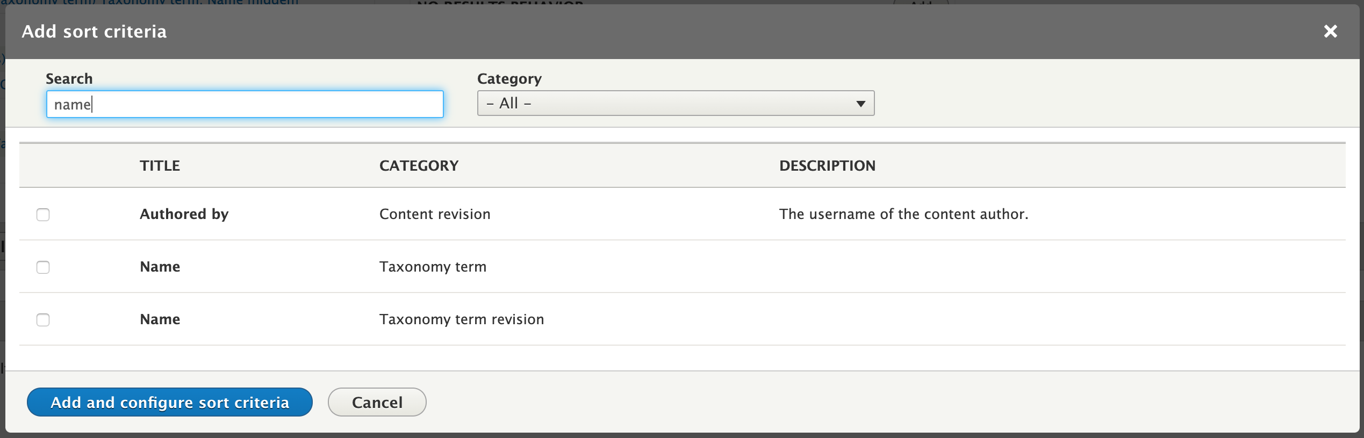
Let’s search for and add the creature type name: this will ensure our headings are alphabetized

Slide 69
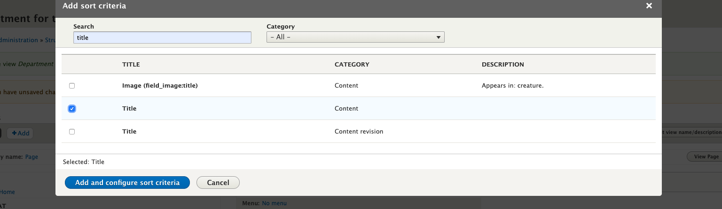
As a second sort criterion we add the title of the creature node so it is alphabetized

Slide 70
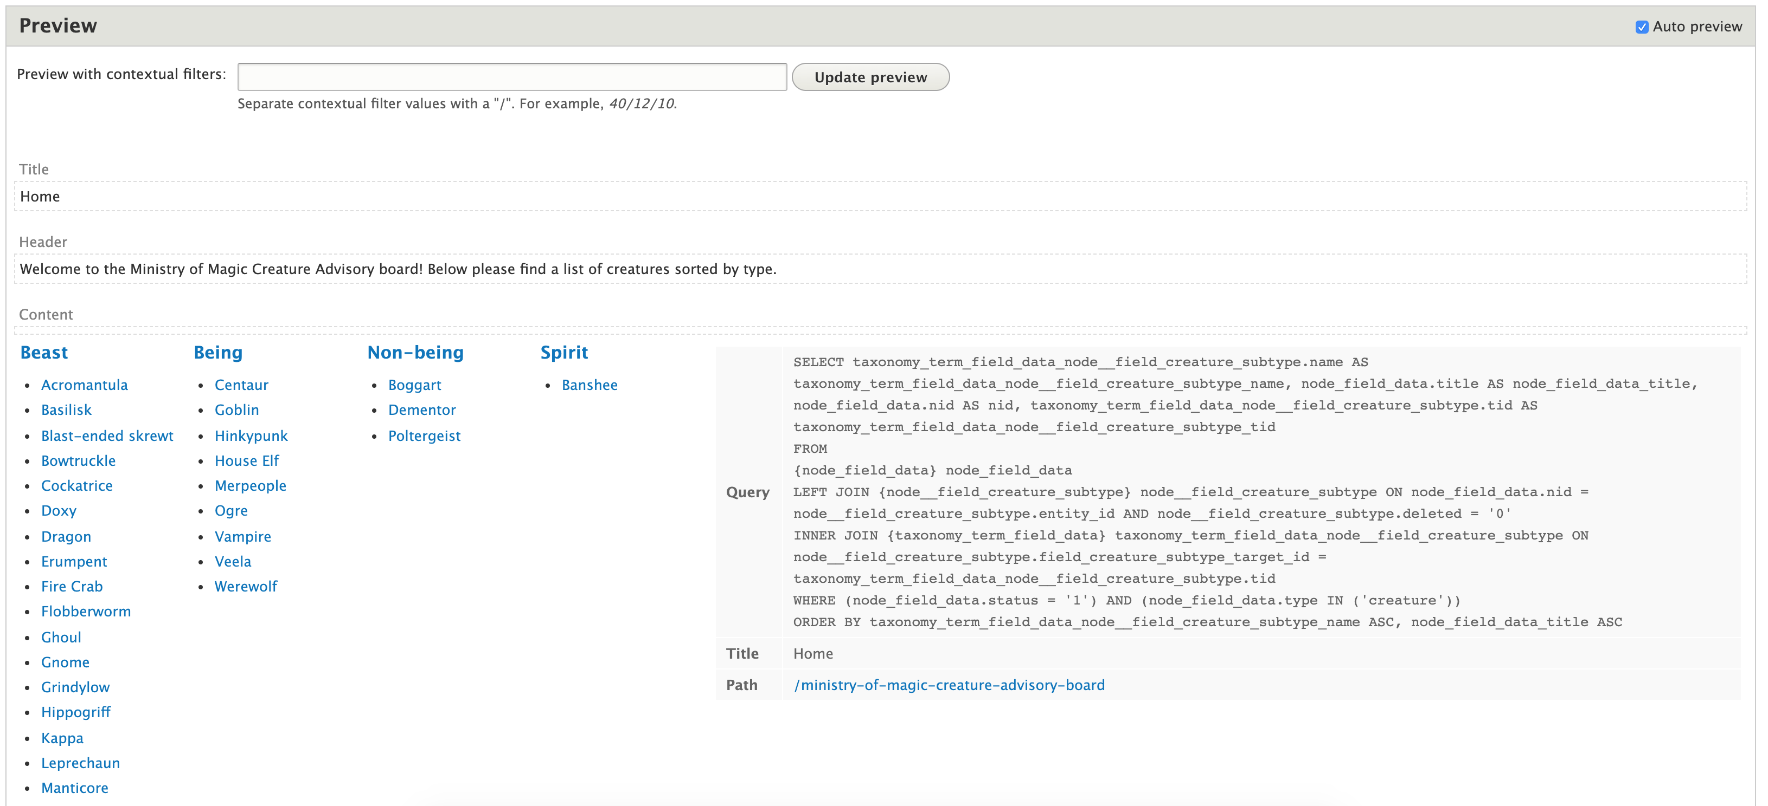
Now our preview shows an organized list under headings
Note that I have the option enabled to show the underlying SQL query

Slide 71
Last, let’s add a header to the page to help explain it

Slide 72
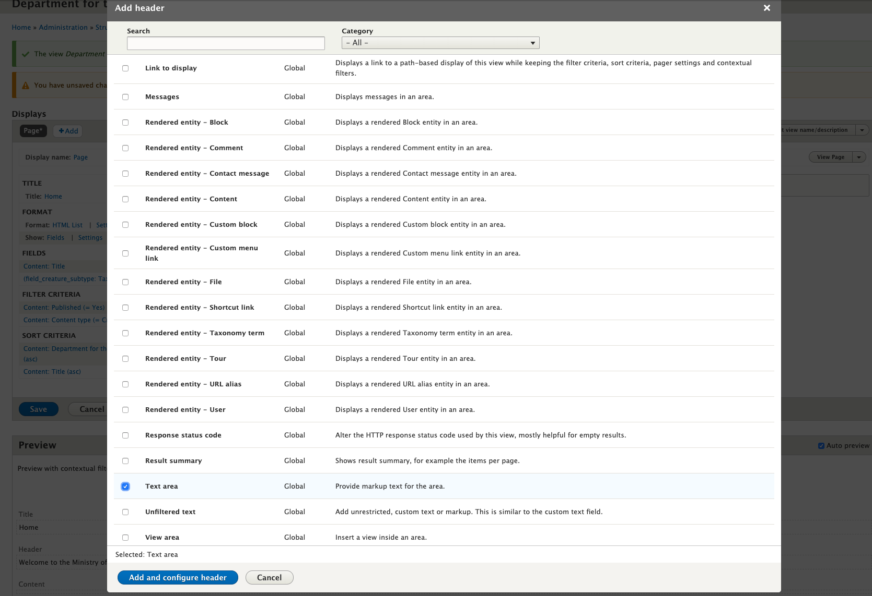
Let’s select a text area

Slide 73
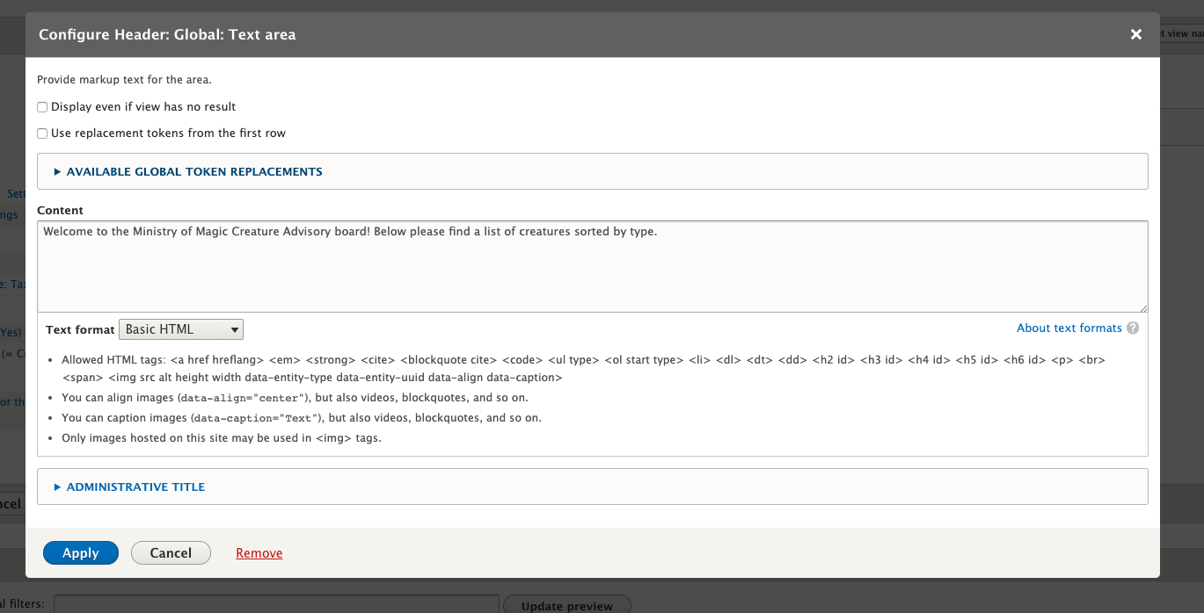
Add some explanatory text and save

Slide 74
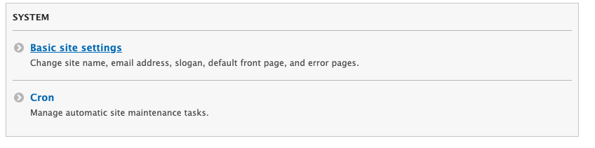
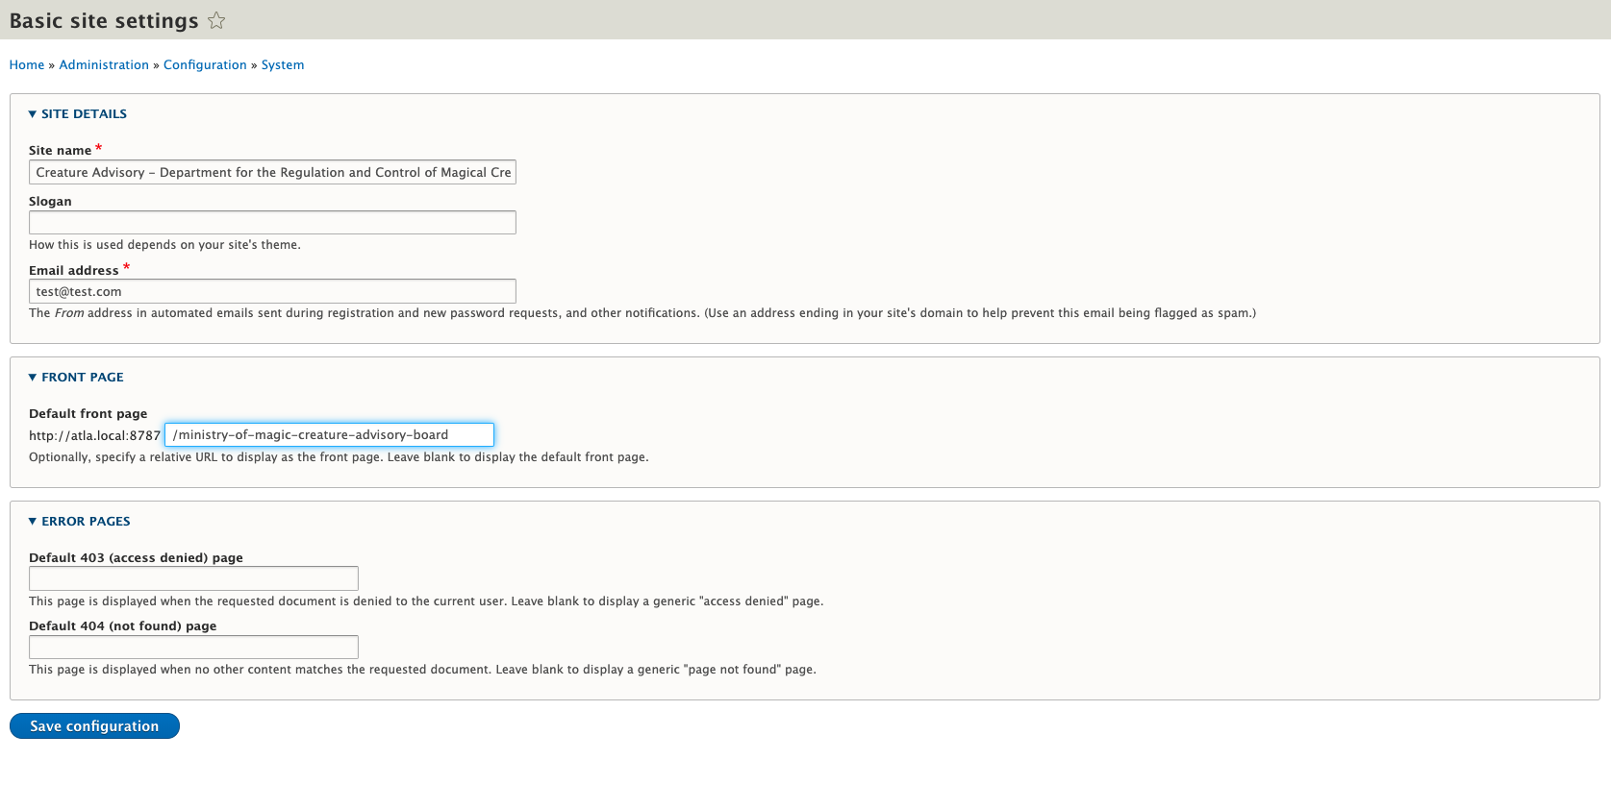
Now let’s make this the front page
The basic site settings under configuration lets us set this as the default front page

Slide 75
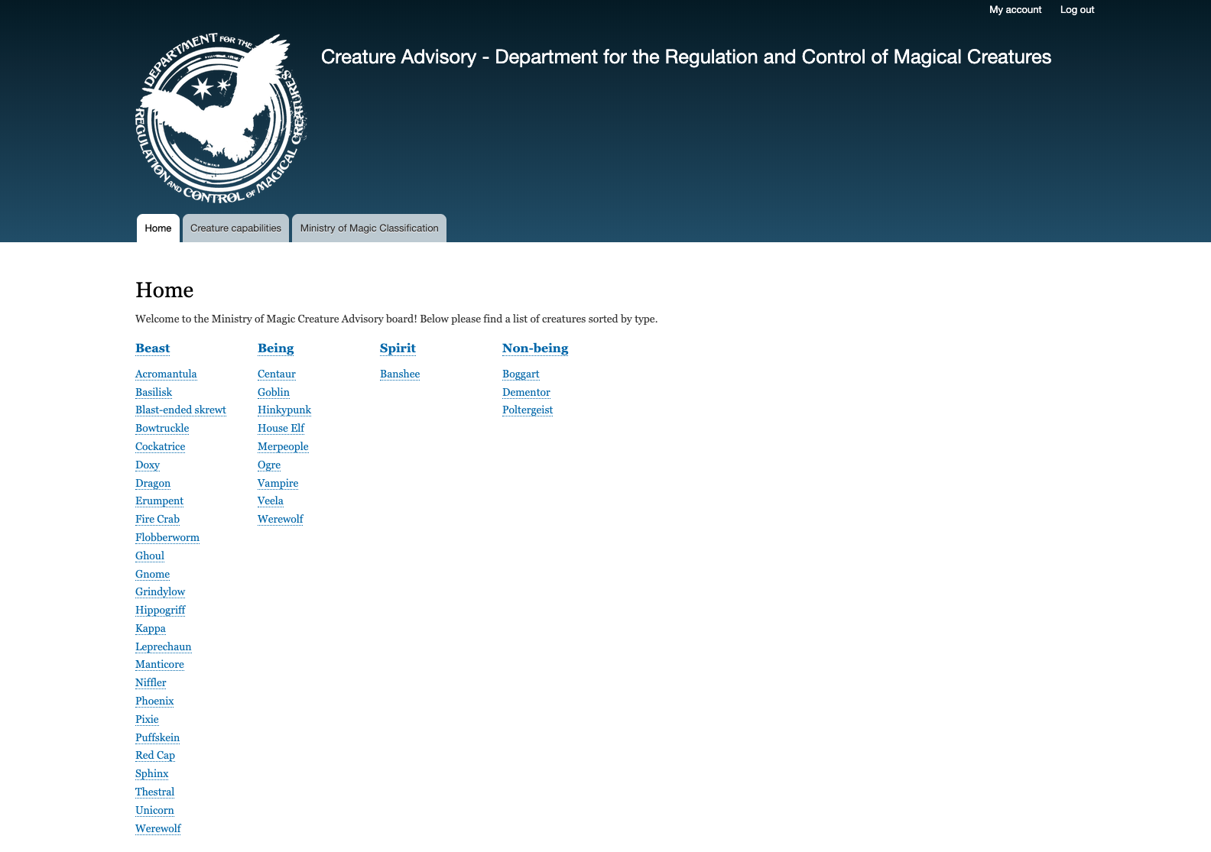
Done!

Slide 76
Is that really everything?

Slide 77
Okay, so there are a few more steps to really fill this thing out, but we need to keep moving.
There’s an appendix at the end of the slide deck. It deals with using pathauto for SEO-friendly URLs and with altering the default taxonomy view.

Slide 78
Some quick taxonomy design principles

Slide 79
Comment #1
Taxonomies blur the line between content and configuration, but they are content, not configuration

Slide 80
This means that your development and deployment tools will need to accommodate some content if you intend to use taxonomies in your site structure
It also means they are not static, and will need careful planning and maintenance in order to keep them in line
If you have separate teams developing the site and its content, this is a crucial point for collaboration

Slide 81
Comment #2
As mentioned before, think twice before using hierarchical taxonomies, and think even harder about using more than one level of nesting

Slide 82
If the views discussion was a lot to take in, getting views to work with hierarchical taxonomies is a lot more complicated
Ask yourself if the representation of the hierarchy actually makes things easier for the user
If you think it’s worth it – Go for it!

Slide 83
Comment #3
Don’t make your categorization too broad … or too narrow

Slide 84
The conflict between the universal and the particular goes back to Socrates
Cast your net too wide and the things you connect will be too dissimilar
Be too particular in your distinctions and you will miss meaningful connections

Slide 85
Some examples:
Uses fire vs. breathes fire – Fire is what’s important and whatever blast-ended skrewts do with fire, it isn’t breathing it. We broadened this feature to make it more useful.
Spirit vs. non-being – Perhaps this is a controversial or inaccurate distinction, but I’ll risk it here. Non-beings like dementors and boggarts are amortal and born out of human emotions, something they have in common that sets them apart from all other spirit-like creatures. We created another division to be more precise

Slide 86
Comment #4
Keep your users in mind and fight for simplicity

Slide 87
When there’s a conflict between the precision we feel is necessary and the simplicity that will make the site easier for users, we need to let go
Sometimes we need to advocate for simplicity against clients or stakeholders
Simple to use sites breed engagement

Slide 88
Conclusion

Slide 89
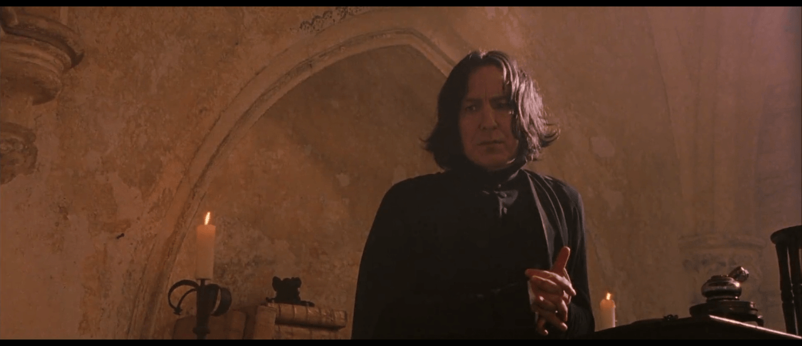
Thank you for joining me for this talk on the subtle science and exact art of taxonomies
Use them well and you will be able to bottle organization, brew user interaction and even put a stopper in your page's bounce rate

Slide 90
THANK YOU, QUESTIONS?

Slide 91
PLEASE PROVIDE YOUR FEEDBACK!
https://mid.camp/6350
The top rated sessions will be captioned, courtesy of Clarity Partners

Slide 92
CONTRIBUTION DAY
Saturday 10am to 4pm
You don't have to know code to give back!
New Contributor training 10am to Noon with AmyJune Hineline of Kanopi Studios

Slide 93
Credit
Images from https://harrypotter.fandom.com
Resources:
https://www.drupal.org/docs/7/organizing-content-with-taxonomy/organizing-content-with-taxonomy
https://www.drupal.org/docs/7/organizing-content-with-taxonomies/guidelines-for-taxonomy-design

Slide 94
Appendix: using pathauto for SEO friendly URLs

Slide 95
For great SEO linking we don’t want undescriptive URLs
/taxonomy/term/9 is meaningless to a web crawler
/habitat/aquatic is a ton better

Slide 96
Steps:
Install pathauto
Set default URL pattern for taxonomy terms
Rebuild URLs for all taxonomy terms

Slide 97
Installing pathauto:
composer require drupal/pathauto
drush en pathauto

Slide 98
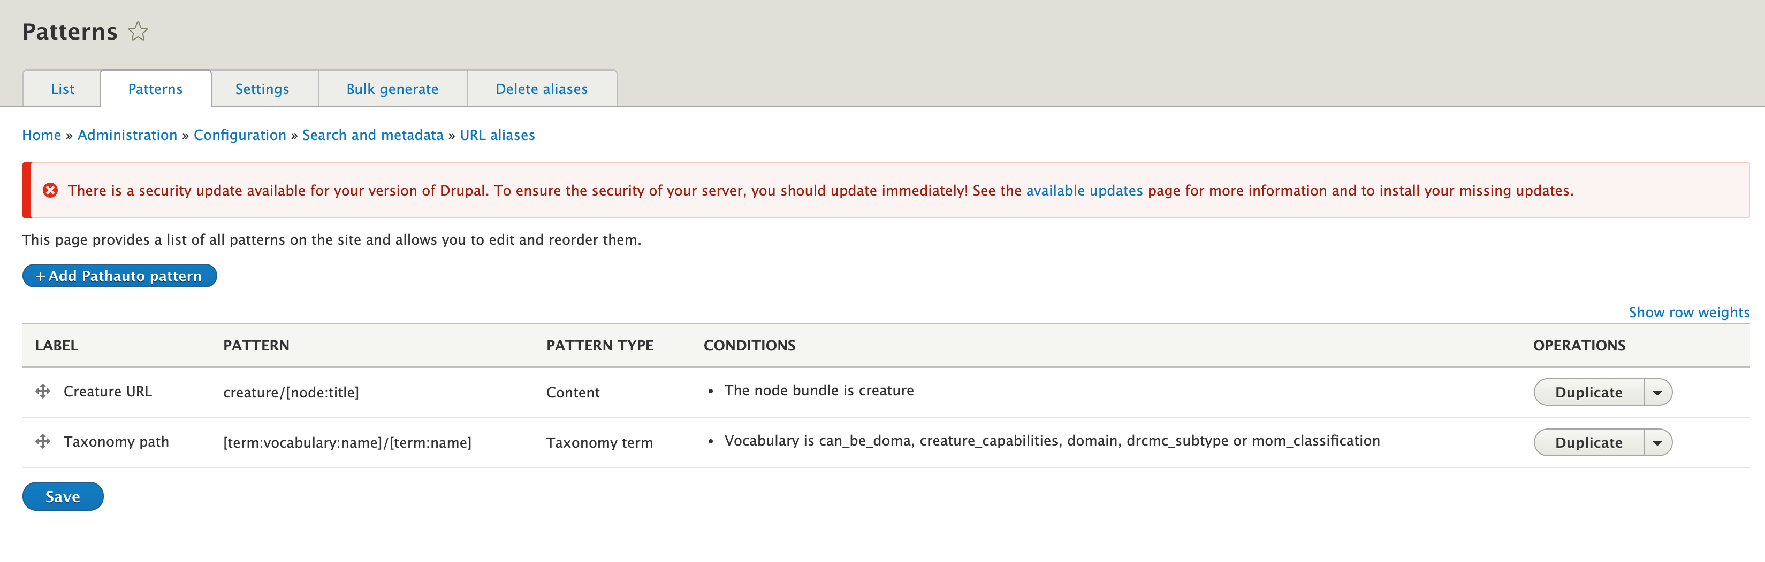
Set default URL pattern for taxonomy terms
Configuration->Url Aliases, Patterns tab
Use something like [term:vocabulary:name]/[term:name] for all taxonomy terms
While you’re there, treat your content types to a good pattern too.

Slide 99
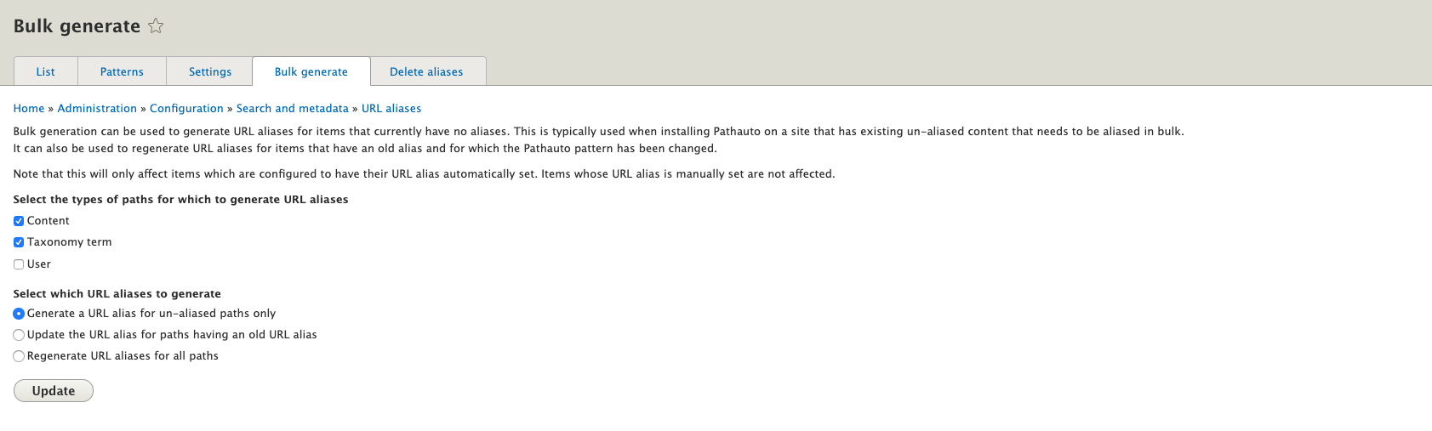
Rebuild URLs for all taxonomy terms
Go to the Bulk Generate tab
Update the paths for all content and taxonomy terms. These are stored in the database and will not reflect your changes until you do this.

Slide 100
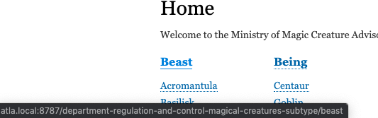
Hover over a header link-it will now be an SEO-friendly link

Slide 101
Appendix: altering the default taxonomy view

Slide 102

Go to Structure->Views and duplicate the existing Taxonomy Term view

Slide 103

Name it something distinct from what it was before

Slide 104

Alter the format and/or fields to fit your design
Alter your sort criteria

Slide 105
New concept: The contextual filter
Filters dynamically based on the context
In this case the context is a wildcard in the URL

Slide 106
The % sign in the path is our wildcard

Slide 107
The contextual filter only shows us content (creatures) that link to the active taxonomy term id

Slide 108

To preview this we have to type in a term id manually – lets use 23, the TID for flight

Slide 109

And if we visit /taxonomy/term/23 we get…

Slide 110
But wait… didn’t we just rewrite that URL with pathauto?

Slide 111

Yeah, we did. But Drupal is smart and the context is still there.
Magically, it still works

